Slide 1
1 digital/dir
1 digital/EN
3 digital/MSx
1 pwm /step
5V circuitry supply
- 12 V supply
- Ground
The connections given for one A4988 motor driver are same for all
V_{mot}
MOTOR DRIVER
A4988
STEPPER MOTOR
Pipe
SERVO MOTOR
V_{mot}
MOTOR DRIVER
A4988
STEPPER MOTOR
Syringe
1 PWM
JETSON NVIDIA AGX XAVIER
ARDUINOMEGA
V_{mot}
Pyserial/ Rosserial
MOTOR DRIVER
A4988
STEPPER MOTOR
Base Rot
1 digital/dir
1 pwm
1 digital/ brk
1 digital/dir
1 pwm
1 digital/ brk
V_{mot}
X 2
MOTOR DRIVER
A4988
STEPPER MOTOR
Ratchet Control
MOTOR DRIVER
RKI-1341
MOTOR DRIVER
RKI-1341
V_{mot}
STEPPER MOTOR
Ratchet Control
MOTOR DRIVER
A4988
DC PUMP
RATCHET WHEEL
REFLECTIVE SPECTROMETER

Slide 2
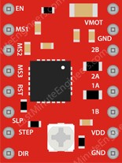
Ratchet Lowering
D 14
12 V
D 19
12 V
D 15
GND
D 20
GND
D 16
D 21
D 17
D 22
D 2
5 V
D 3
5 V
D 18
GND
D 23
GND

Slide 3
Syringe Pipe Lowering
D 24
12 V
D 29
12 V
D 25
GND
D 30
GND
D 26
D 31
D 27
D 32
D 4
5 V
D 5
5 V
D 28
GND
D 33
GND

Slide 4
Base Rotation
D 34
12 V
D 35
GND
D 36
D 37
D 5
5 V
D 38
GND

Slide 5
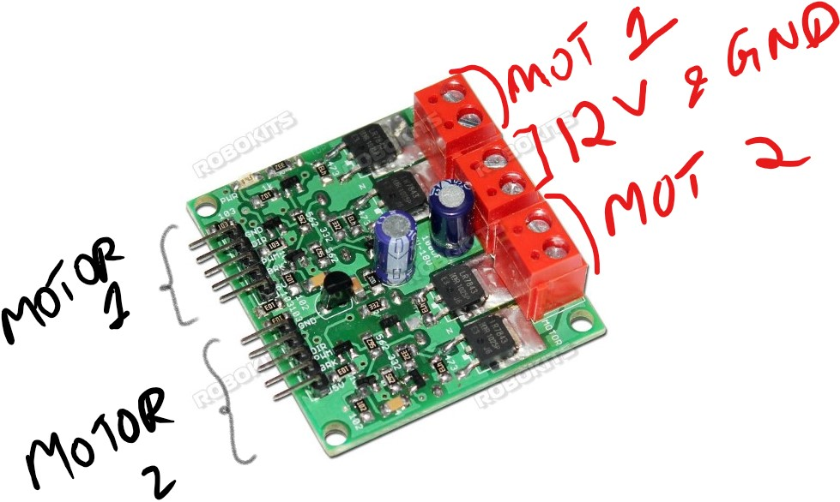
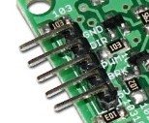
RKI-1341

Slide 6
DC submersible pump and Reflective Spectrometer
GND
gnd
D 39
dir
DC Submersible punp
D 6
Pwm
D 40
brk
5v
12v and gnd
GND
gnd
D 41
dir
Pwm
Reflective spectrometer
D 7
D 42
brk
5v
NOTE – 5V PINS ARE OUTPUT PINS.

Slide 7
Ratchet wheel
Servo Motor
GND
gnd
power
5v
D 43
dir
Signal
D 8
D 7
Pwm
Motor 1
Gnd
gnd
D 44
brk
5v
12v and gnd
gnd
dir
Pwm
brk
5v

